Slide 1
The Classical Style
700-30 B.C.E.

Slide 2
“Classical” or “Classic”
An Introductory Discussion
What images are conjured in your mind as you think of this word?
Does it differ as you consider music? Clothing? Theatre? Art?
What traits make art or music something that is a “classic”?

Slide 3
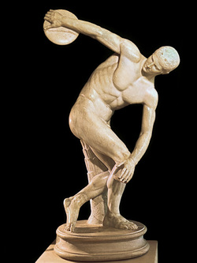
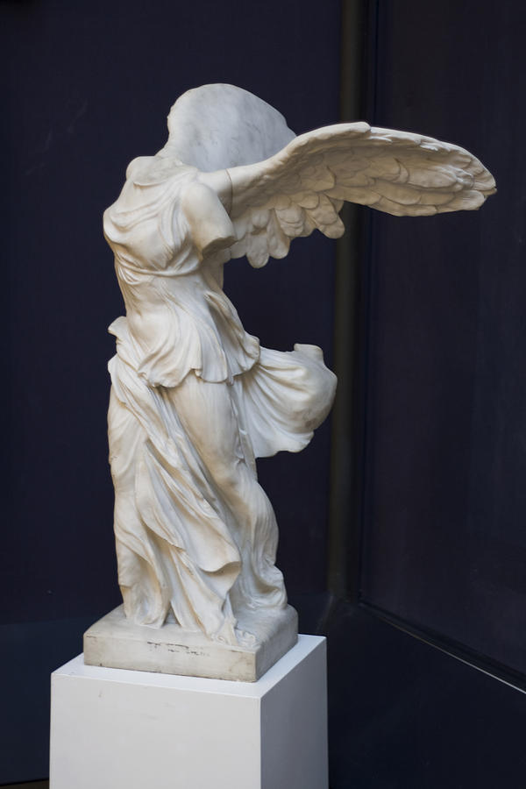
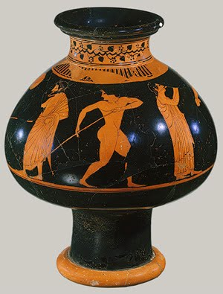
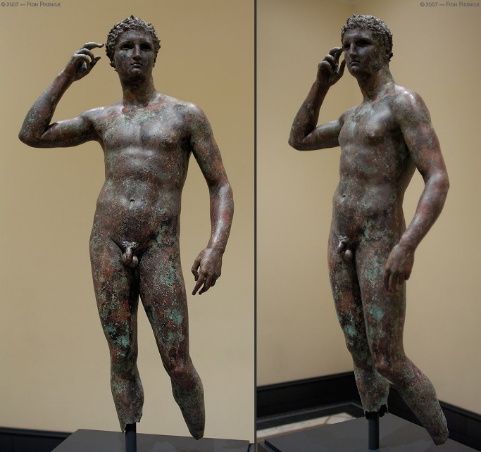
Nike of Samothrace- Pythocritos of Rhodes
Clay vase, by the potter Pamphalos and painted by Oltos
Discobolus by Myron
Hermes by Lysippos

Slide 4
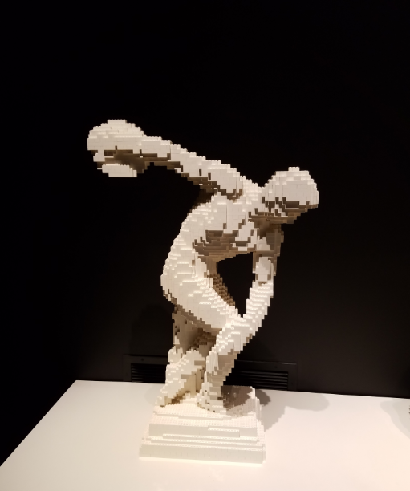
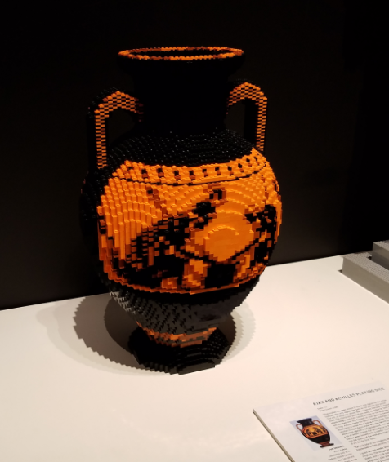
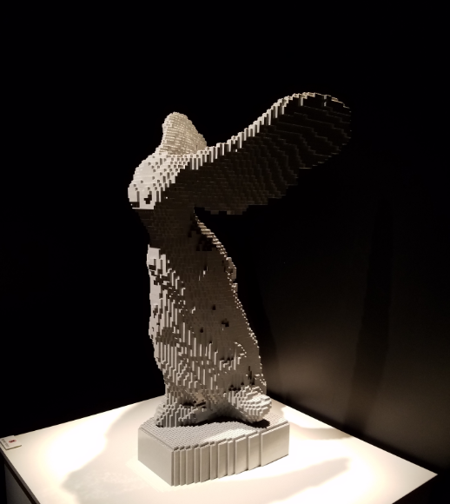

Slide 5
Greek Sculpture: The Archaic Period (700-480 B.C.E.
Freestanding Greek sculptures fulfilled the same purpose as Mesopotamian and Egyptian statues: they paid homage to the gods.
They also served as cult statues, funerary monuments, and memorials designed to honor the victors of athletic games.
The collapse of the Minoan and Mycenaean civilizations after 1200 B.C.E., led to the Greek Dark Ages. As the Archaic period of art blossomed, the influence of the Egyptians is apparent in the look of stiffness and rigidity of the early Greek sculpture.
The Greek affection for the natural beauty of the human body made the nude statue completely appropriate to visual representation. The fig leaf seen on many Greek sculpture to cover the genitals was a later addition by the people of the new Christian faith.
To achieve the delicate balance between the real and the ideal, Greek artists began to utilize aspects such as carved abdominal, knee, and calf muscles, precious stones used as eyes, and brightly colored paint on the lips, hair, and other parts of the figure.

Slide 6
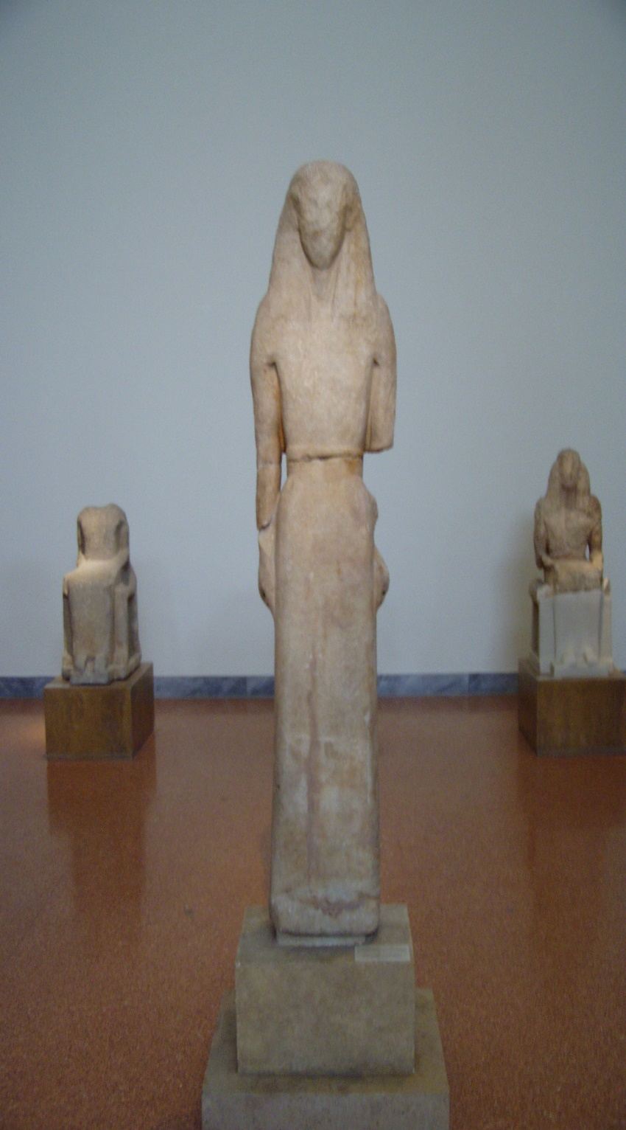
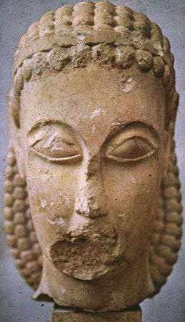
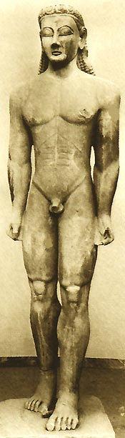

Slide 7
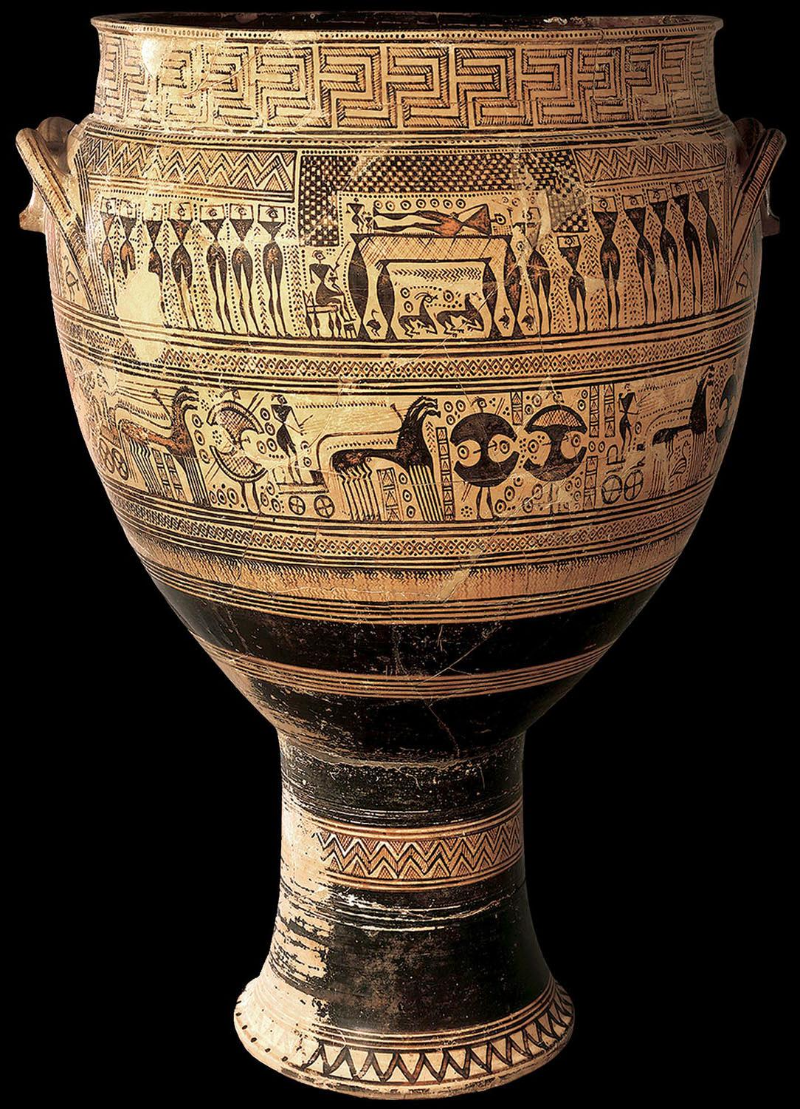
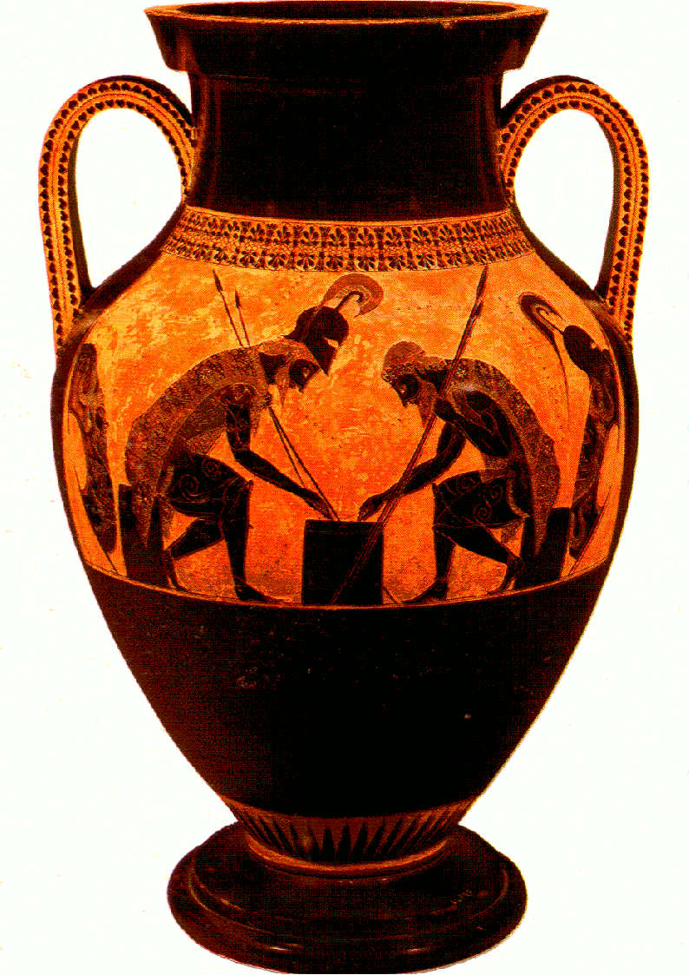
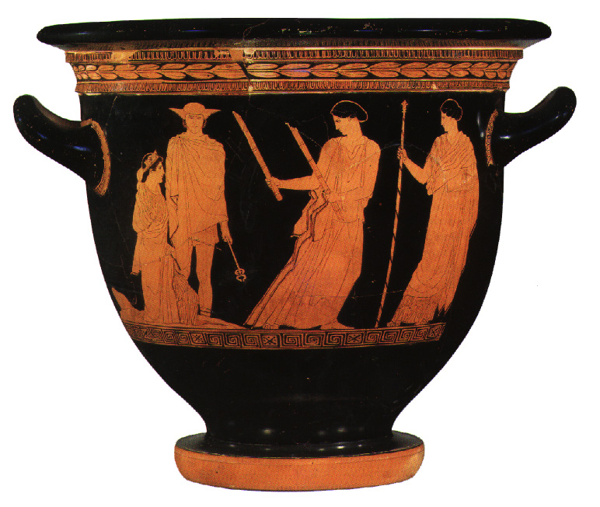

Slide 8
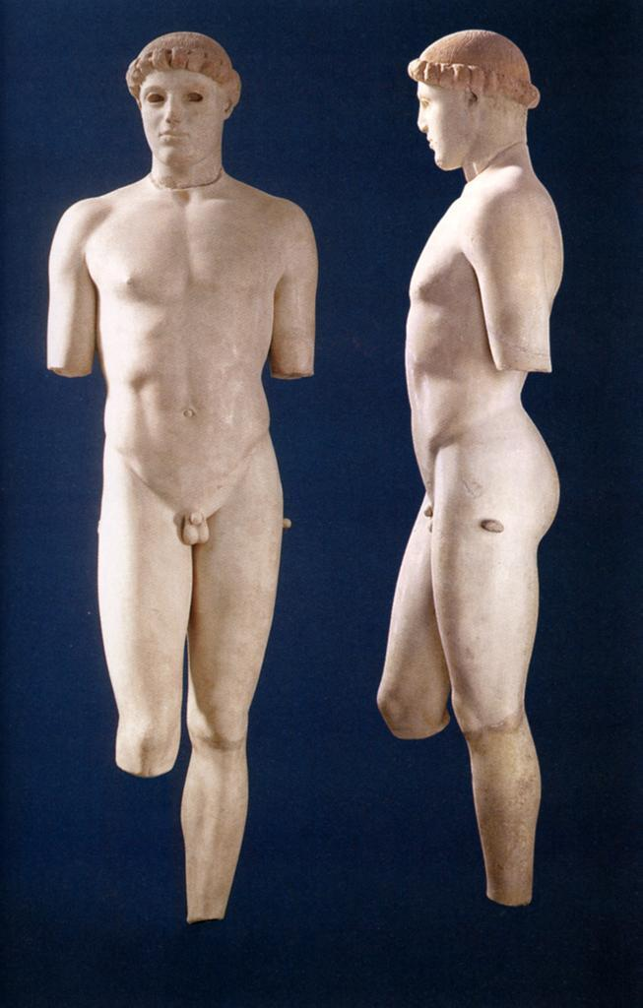
The Classical Style
The word “classical” when referring to the contributions of the Greeks, describes a style of creative expression marked by clarity, simplicity, balance, and harmonious proportion. The Greek “classics,” shown through their literature, philosophy, music, and the visual arts, provided a standard of beauty and excellence that was preserved and imitated for centuries.
The quest for harmonious proportion was a driving force behind the evolution of the classical style. The Greeks believed that if nature itself obeyed laws of harmony and proportion, than the artists job should be to imitate those same laws within their art.
Among Greek artists and architects, such ideas spawned a desire for a set of rules or canon, for determining physical proportion.
In the human body, the distance between the chin and the top of the forehead, representing one-tenth of the whole body height, constituted a module by which body measurement might be calculated.

Slide 9
Humanism, Realism, and Idealism
Humanism- Greek art is said to be humanistic not only because it observes fundamental laws derived from the human physique, but because it focuses so consistently on the actions of human beings.
Greek art is fundamentally realistic, or, faithful to nature…
However, the Classical artists refine nature in a process of idealization, that is, the effort to achieve a perfection that surpasses nature.
What is left of early Classical art exists in the form of ceramic wares. Scenes from mythology, literature, and everyday life became the focal point of the painted vases, with the daily activities of the Greeks: working, dancing, feasting, fighting, and gaming, being recorded for posterity.

Slide 10
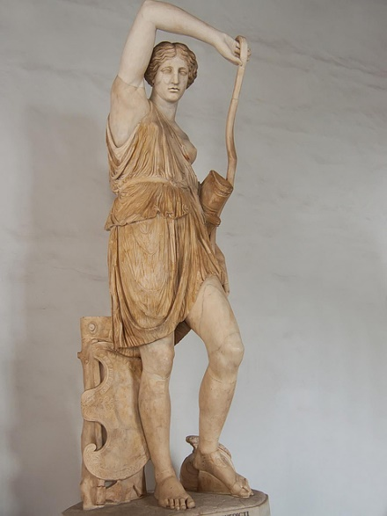
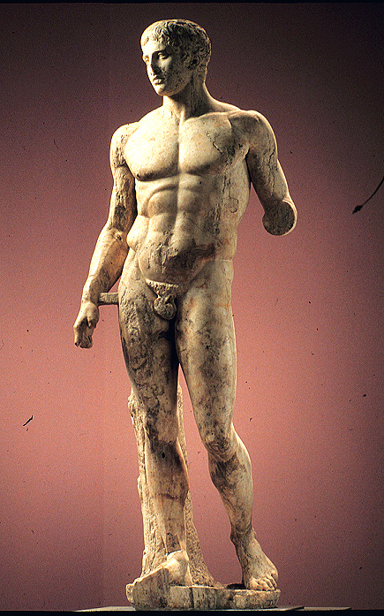
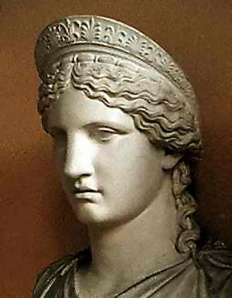
Polykleitos and the Contraposto Style:
Considered one of the most important sculptors of Classical antiquity.
Most famous piece is the Doryphoros, or “Spear-bearer.” Also attributed with creating a colossal gold and ivory statue of Hera, as well as many portrait busts.
Innovator of the contraposto style, where the weight of the statue was placed on one leg, and the torso was turned on the spines axis.
Polykleitos created a new approach to sculpture exemplifying his aesthetic theories of the mathematical bases of artistic perfection. His general claim was clarity, balance, and completeness.
Polykleitos determined that a statue should be composed of clearly definable parts, all related to one another through a system of ideal mathematical proportions and balance.

Slide 11
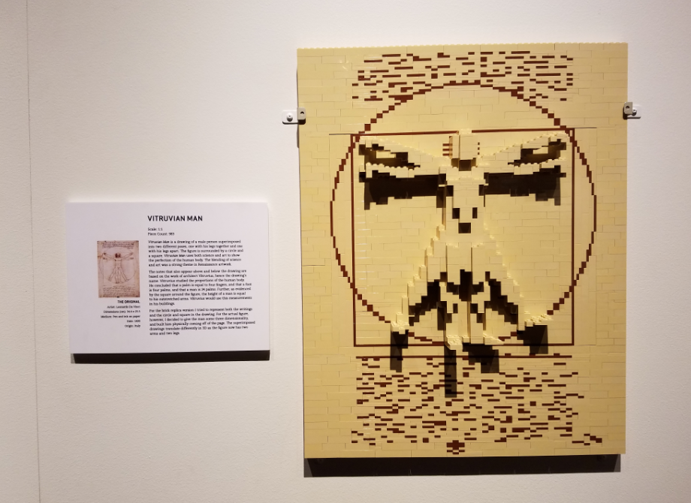

Slide 12
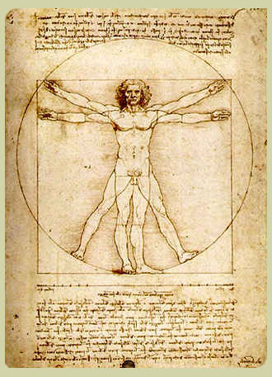
What Makes A Man?- The Vitruvian Model
Greek artists and architects fixed on a module, or standard of measurement, that governed the relationship between all parts of the work of art and the whole. The module was not absolute, but varied according to the subject matter.
The Greek module made use of the principal of proportion known as symmetry, defined as correspondence of opposite parts in size, shape, or position, as is evident in the human body.
Among the best sources of information to understand the Greek module is The Ten Books on Architecture written by the Roman architect and engineer, Vitruvius Pollio.
In defining the Classical canon and module, Vitruvius advised that the construction of a building and the relationship between its parts must imitate the proportions of the human body.
Without proportion, Vitruvius argued, the correspondence between the various parts of the whole, there can be no design. And without design, there can be no art.

Slide 14
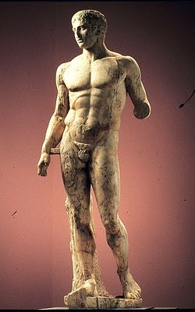
Compare and Contrast
How do these two figures differ in style?

Slide 15
The Classical Female Ideal:
The early female figure or Kore, went through a different evolution than the male.
Early Kore were fully clothed and did not appear in the nude until the fourth century B.C.E.
Female statues of the Archaic period were ornamental, columnar, and smiling. It was not until the late Classical Age did the Greek sculptors arrive at the sensuous female figures that inspired the Hellenistic and Roman artists.
This Late Classical Age concludes with some important general observations concerning the Classical ideal: increasing realism, freed of incidental detail.
Human imperfections such as wrinkles, warts, and blemishes are purged in favor of a radiant flawlessness. The ideal figure was neither very old nor very young, neither very thin nor very fat. She is eternally youthful, healthy, serene, dignified, and liberated from all accidents of nature. Do you think this puts limits on creativity as an artist? How do the following figures differ in style and execution?

Slide 16
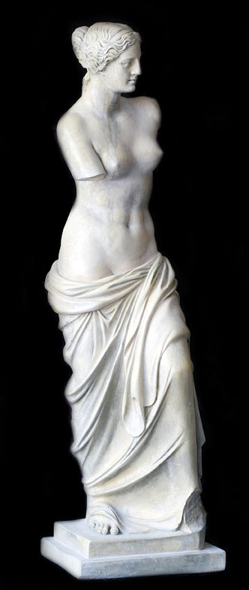
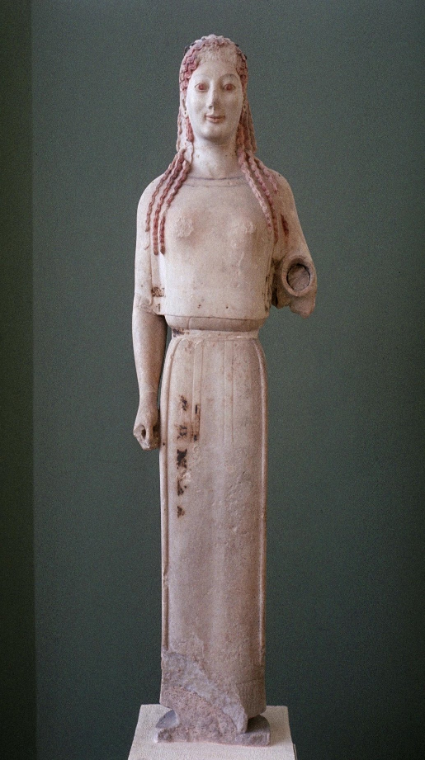
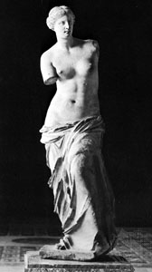

Slide 17
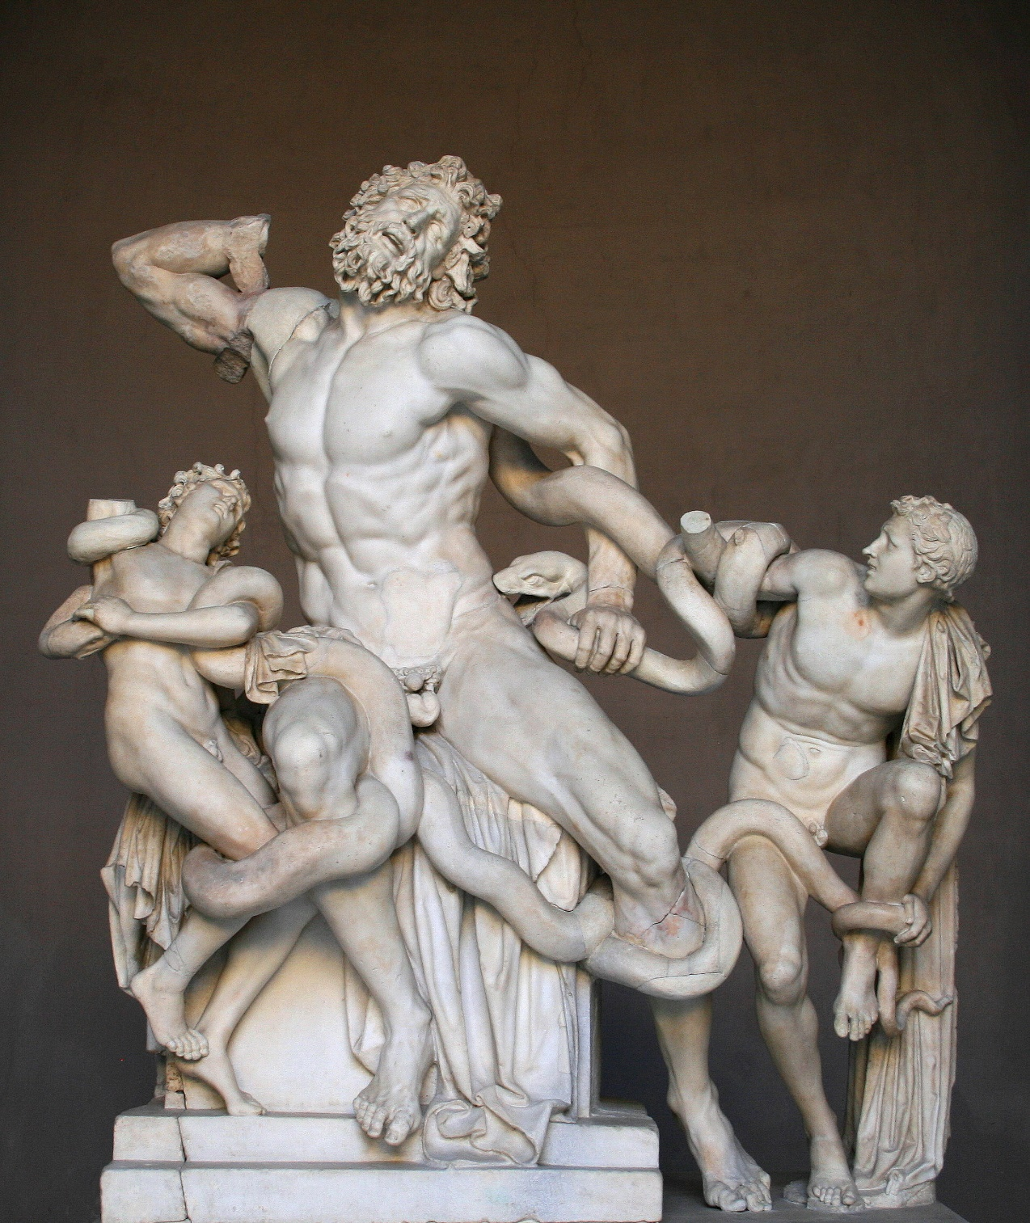
Hellenistic Art:
The Hellenistic era covers the period from the death of Alexander the Great in 323 BCE to the accession of the first Roman emperor in 27 BCE. Alexander’s conquests had spread Greek culture across Egypt and Asia, and the city of Alexandria had become the center of the Hellenistic world.
Among sculptors of this period was a growing taste for figures that conveyed fiery emotions or violent movement. This could be achieved by a contorted pose or elaborate swinging drapery.
There was a new interest in humorous or low-life themes such as aged drunks, comic actors, and list-filled satyrs, and these themes became more acceptable as state patronage of art gave way to private ownership of pieces.

Slide 18
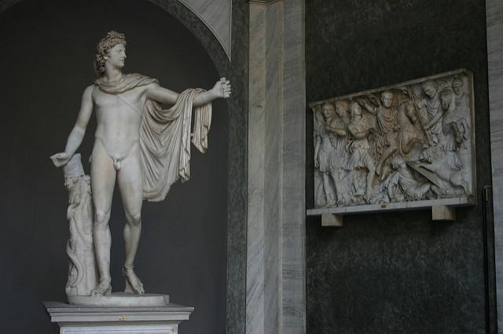
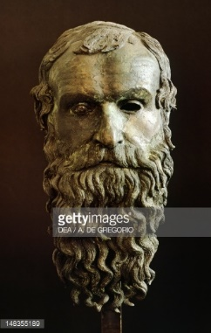
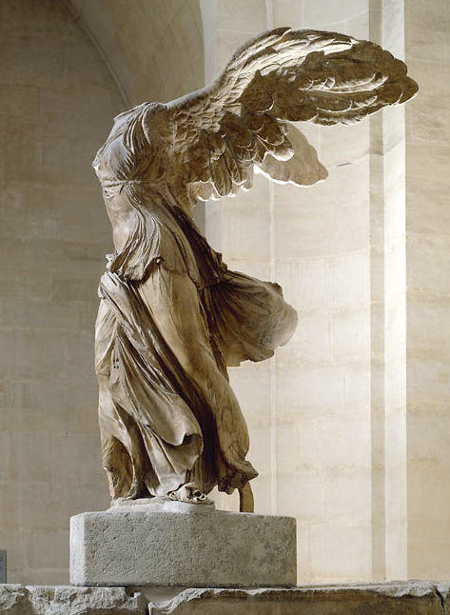
Left: The Apollo Belvedere
Leochares, 320 B.C.E.
Above: The Philosopher’s Head
Unknown, 250 B.C.E.
Right: Winged Victory
Unknown, 250 B.C.E.

Slide 19
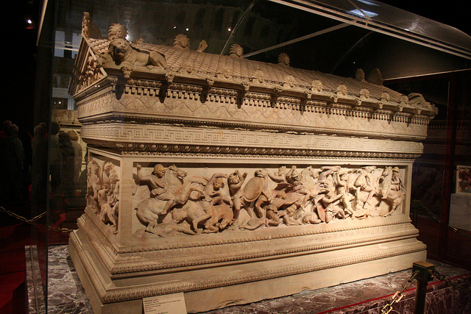
The Alexander Sarcophagus, 333 B.C.E.

Slide 20
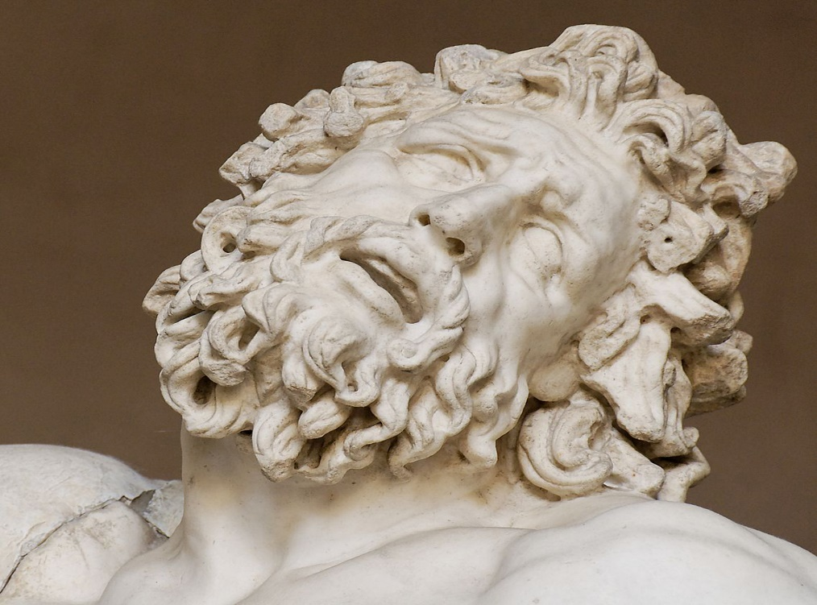
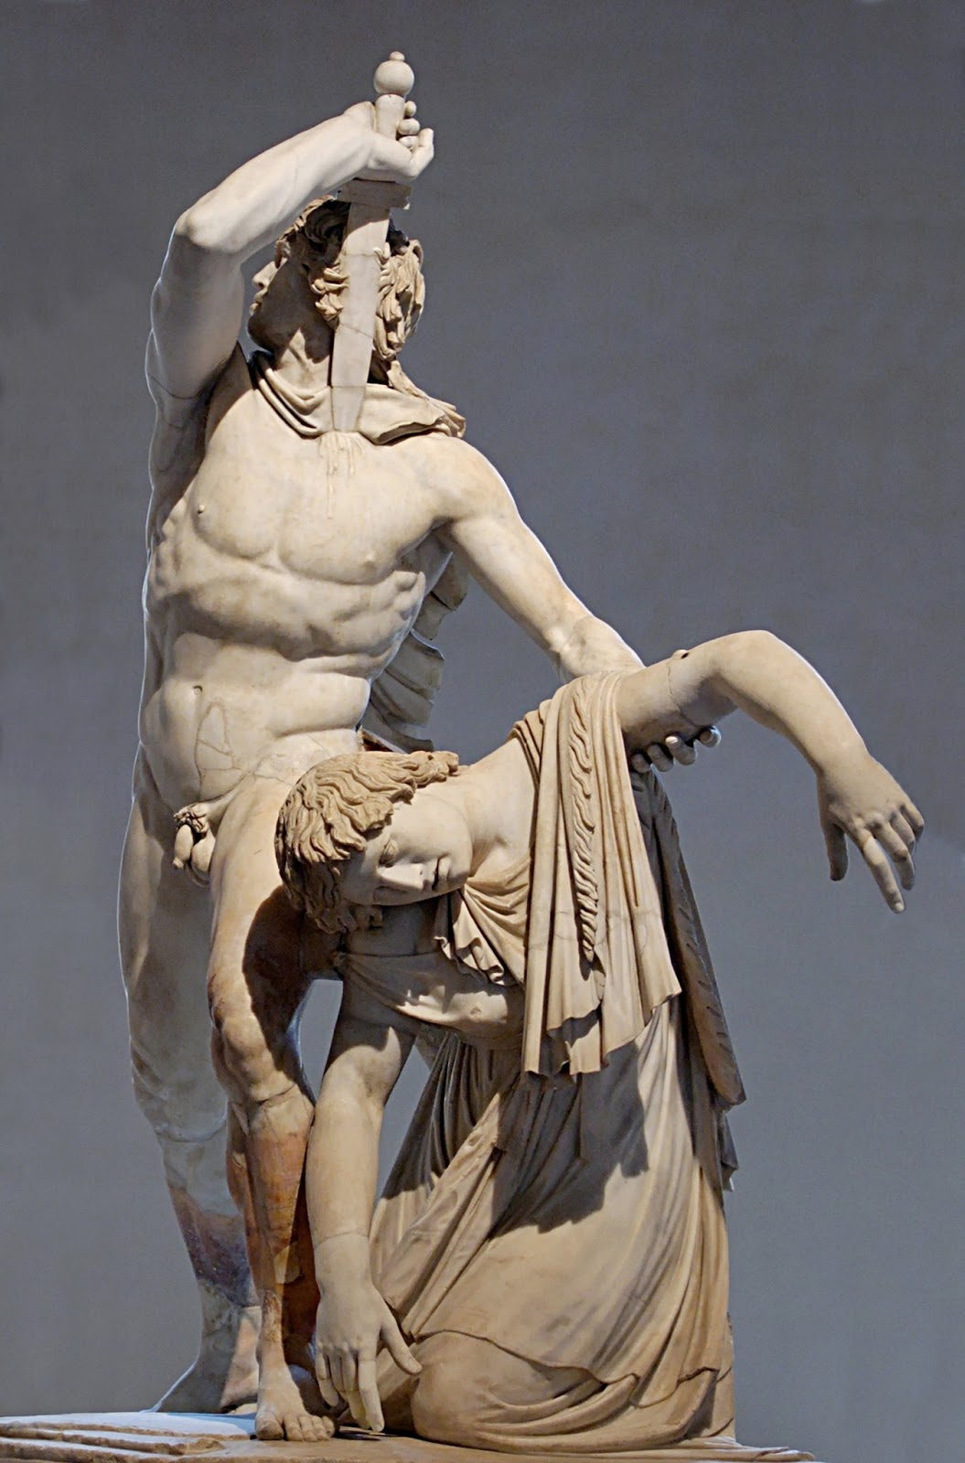
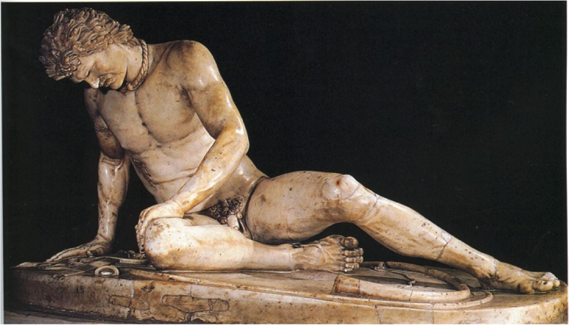
Later Hellenistic Art:
Gaul Sculptures, Attalus

Slide 21
Greek Architecture: The Parthenon:
The great monuments of Classical architecture were designed to serve the living, as opposed to the Egyptian architectural purpose, which was to serve the dead. Greek theaters celebrated life on earth, instead of life in the hereafter, and Greek temples served as shrines to the gods and depositories for civic and religious treasures.
The outstanding achievement of Golden Age Athens is the Parthenon. This temple is dedicated to Athena, the goddess of wisdom. The name Parthenon derives from the Greek word Parthenos, meaning “maiden” or “virgin,” popular epithets for Athena.
Begun in 447 B.C.E and finished in 432 B.C.E., the Parthenon represents the apex of a long history of post-and-lintel temple building among the Greeks, and that history entailed a search for harmonious proportion, as vividly shown in the monument.
The Parthenon makes use of Doric order, one of three architectural design programs created by the Greeks. The Doric order is simple and severe, and in the Parthenon reached its most refined expression.
Standing on its hill the Parthenon is visible from miles around, especially from the ships crossing the sea from afar, the manifest evidence of Athenian wealth and power. For nearly 900 years it was a temple to Athena, for 1,000 years it was a Christian church, and for 200 years it was a Muslim mosque.

Slide 22
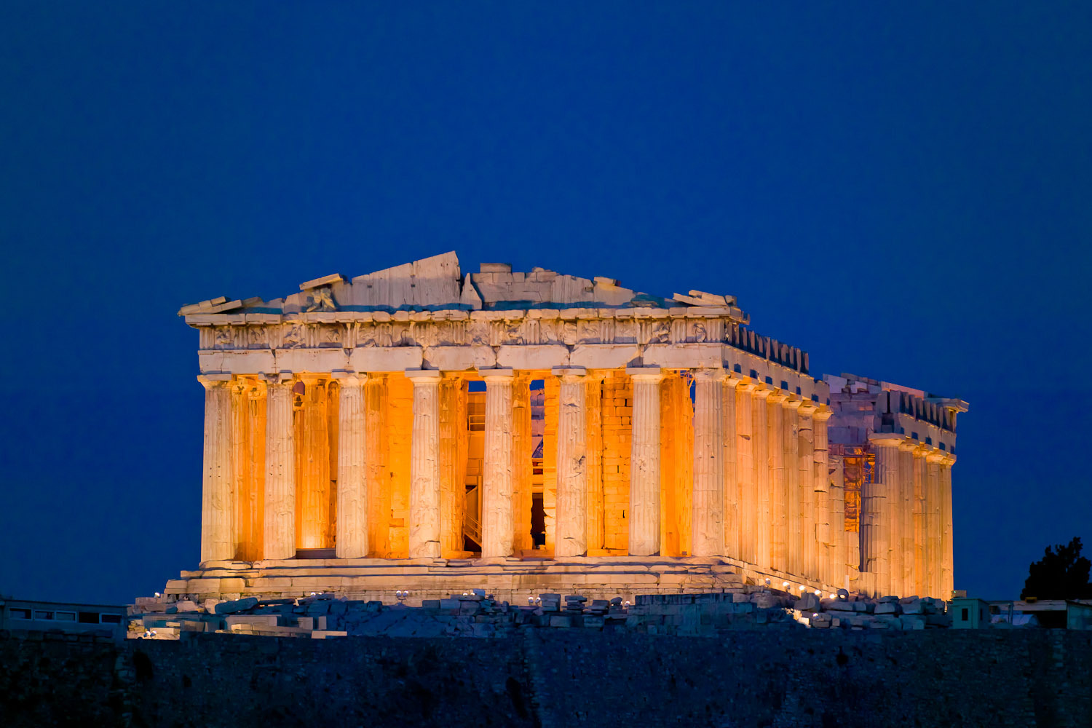
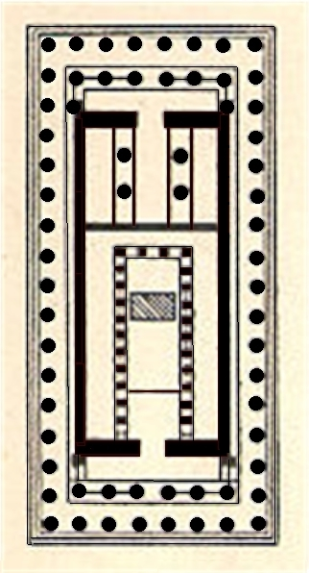
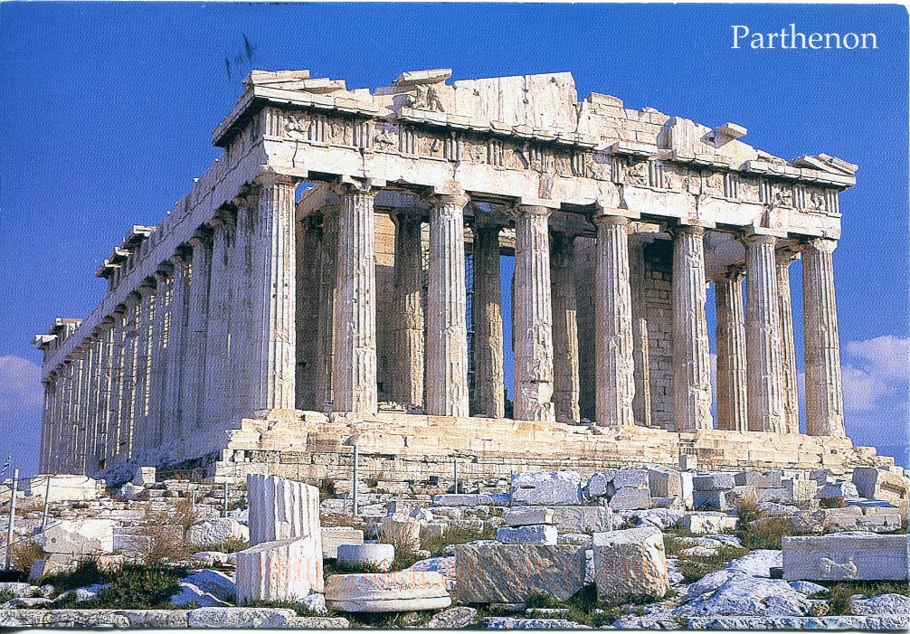

Slide 23
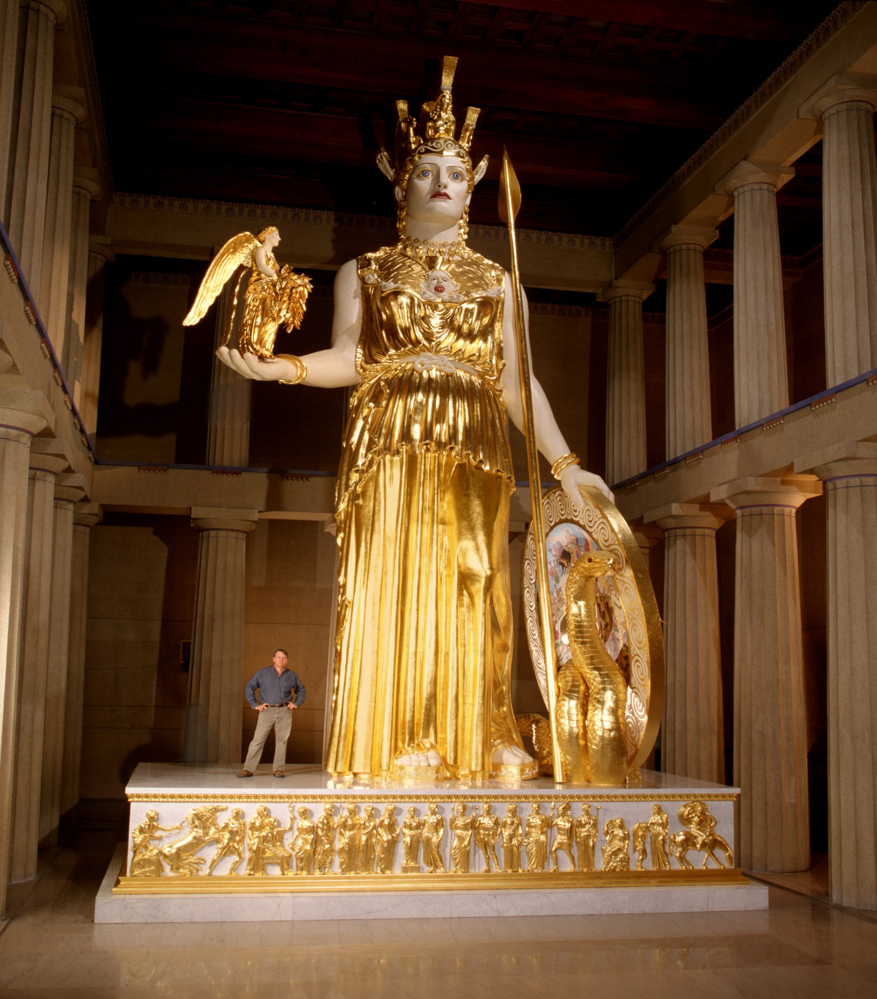
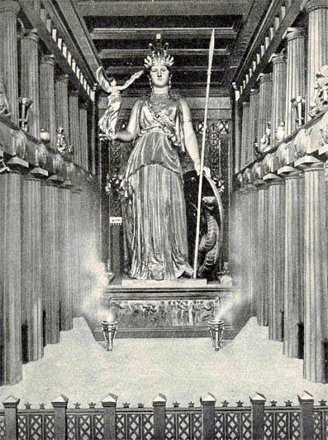

Slide 24
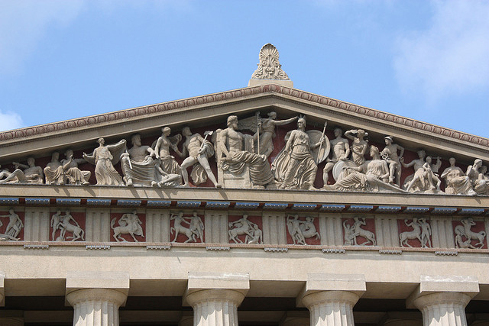
Sculpture of the Parthenon, Phidias
The sculptures of the Parthenon appear in three locations: in the pediments of he roof gables, on the square panels between the beam ends under the roof, and in the area along the outer wall.
Brightly painted, the Parthenon sculptures relieved the stark angularity of the post-and-lintel structure.
The east pediment depicts the birth of Athena, with the gods and goddesses in attendance.
The east pediment of the Parthenon

Slide 25
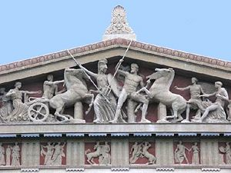
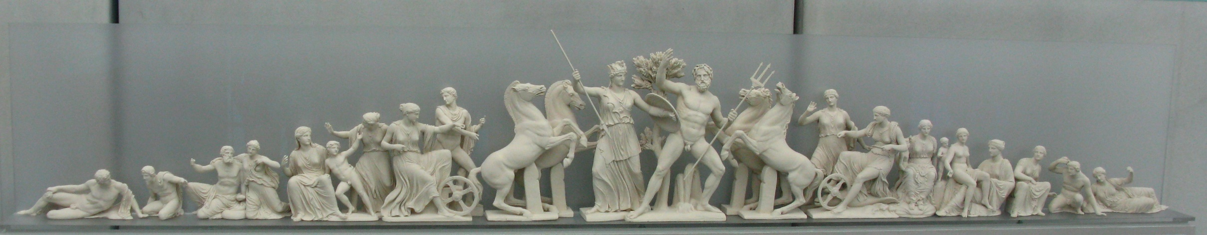
The west end pediment of the Parthenon:
The west end pediment of the Parthenon depicts the contest between Poseidon and Athena for domination of Athens.
The 92 images within the pediment and the accompanying frieze, illustrate the legendary combat between the Greeks, and Giants, Amazons, and Centaurs.
Appropriate to a temple honoring the goddess of wisdom, the sculptural program of the Parthenon celebrates victory of intellect over barbarism.

Slide 26
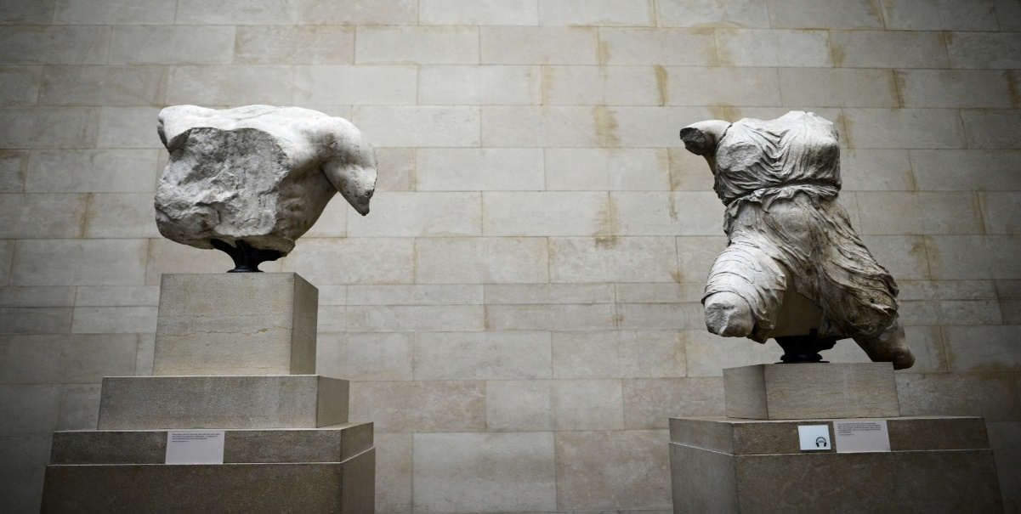
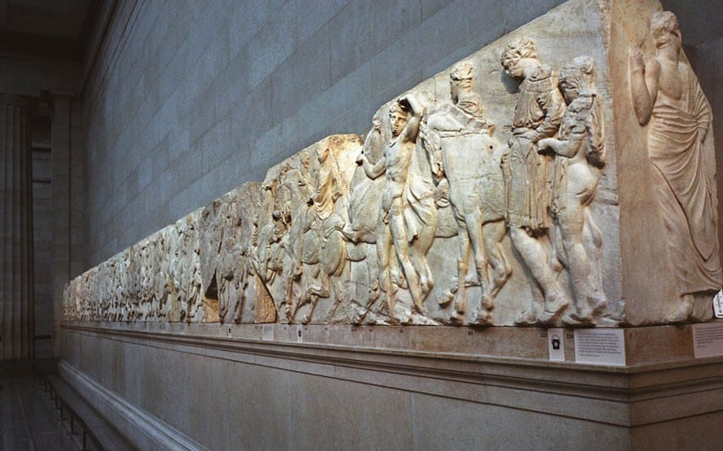
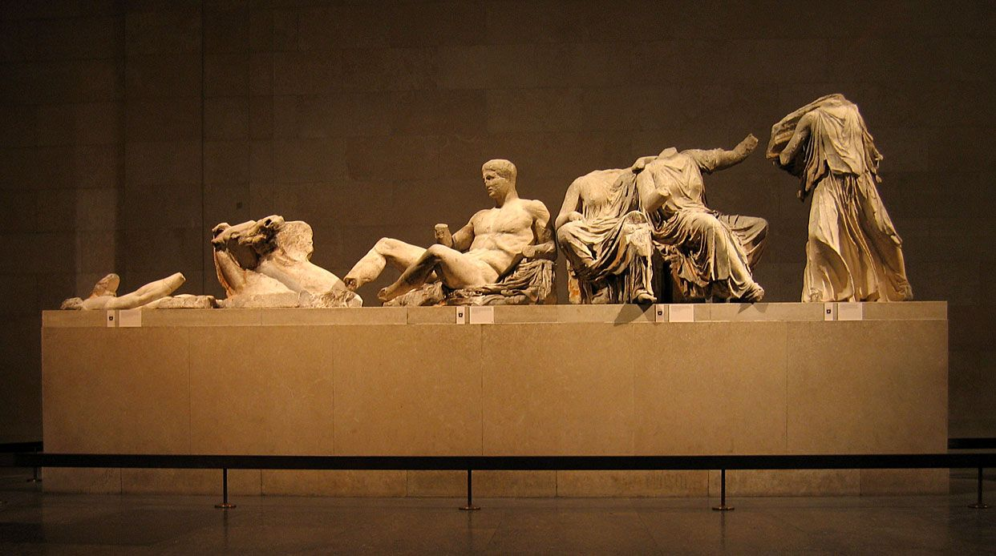
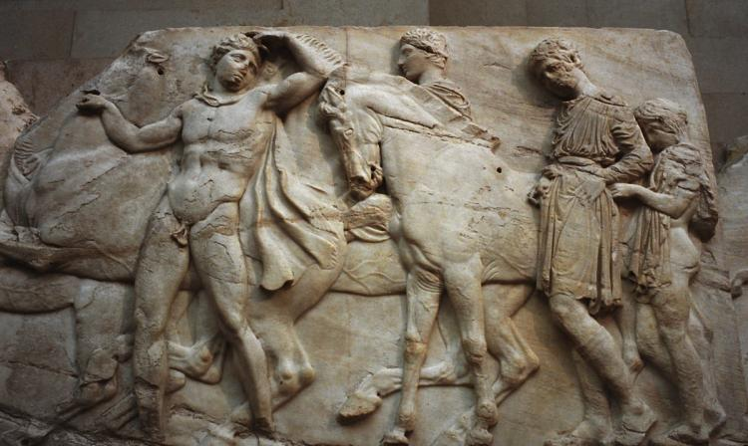
The Elgin Marbles:

Slide 27
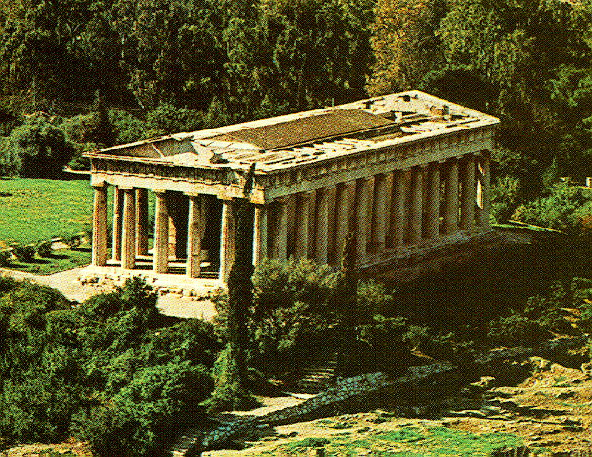
Theseion Temple, 449 BCE

Slide 28
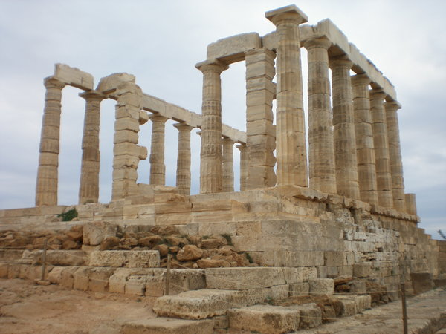
Temple of Poseidon, 440 BCE

Slide 29
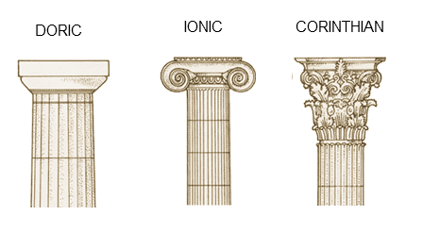
Three Great Orders of Columns

Slide 30
Compare and Contrast
What modern buildings remind you of the Parthenon?
What cities or locations within cities are these types of buildings typically found?
What purpose do these modern buildings usually serve?
How do these modern purposes compare to both Greek philosophy and political structures?

Slide 31
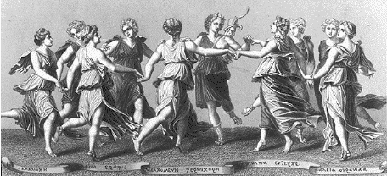
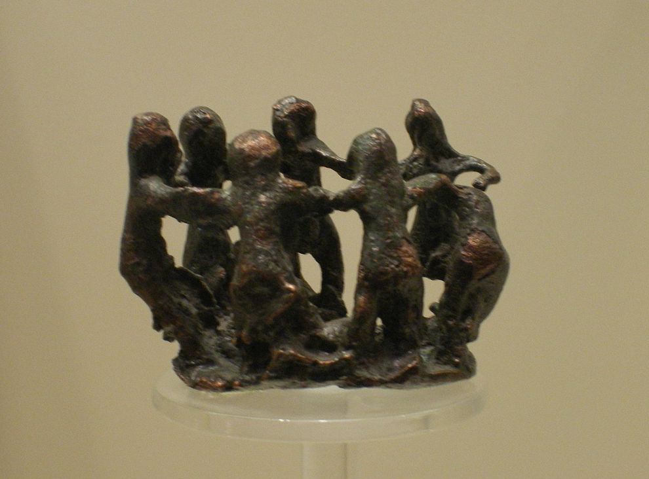
Greek Dance:
There are over 10,000 traditional dances from the regions of ancient Greece, with each region formed it’s own choreography and style to fit into their specific ways of life.
Primarily social, these dances brought the community together for special times each year, like the Grape Festival, patronal festivals, weddings and funerals.
Dances generally had set patterns, and utilized many musical instruments during dances. Some instruments used were bells, tambourines, lyres, and flutes.
Dance was valued as a connection to the gods who they believed created dance.

Slide 32
The Classical Style in Poetry:
In Classical Greece, distinctions between individual forms of artistic expression were neither clear-cut or definitive. A combination of the arts prevailed I most forms of religious ritual and in public and private entertainment.
The Hellenic culture produced an impressive group of lyric poets, the greatest of whom was Sappho. Born into an aristocratic family on the island of Lesbos, Sappho instructed a group of women, dedicated to Aphrodite, in the production of lyric poetry.
Regarded as “the female Homer,” Sappho produced some nine books of poems, of which only fragments remain. Most of the surviving poems are concerned with erotic love, even though Sappho was herself married with a daughter.
Ancient and modern poets alike admired Sappho her economy of expression, an her inventive combinations of sense and sound. Sappho wrote with deceptive simplicity, often in 4-line verses, couplets, or even single lines.

Slide 33
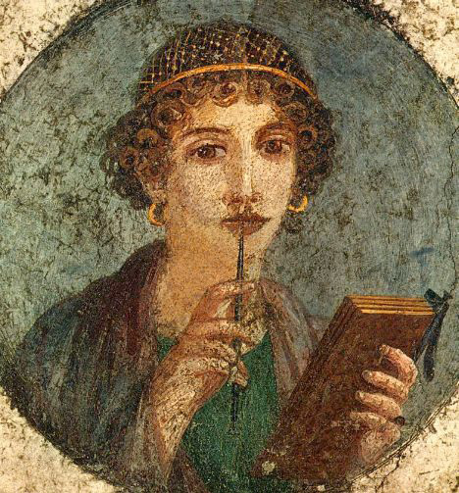
The Poetry of Sappho
He is more than a hero
He is a god in my eyes
the man who is allowed
to sit beside you-he
who listens intimately
to the sweet murmur of
your voice, the enticing
laughter that makes my own
heart beat fast. If I can’t
speak—my tongue is broken;
a thin flame runs under
my skin; seeing nothing,
hearing my own ears
drumming, I drip with sweat;
trembling shakes my body
and I turn paler than
dry grass. At such times
death isn’t far from me
Although they are
only breath, words
which I command
are immortal.
On the black earth, say some, the thing most lovely
Is the host of horsemen, or some, foot soldiers
Others say of ships, but I-
Whatsoever
Anyone loveth

Slide 34
The Classical Style in Music and Dance:
The English work music derives from muse, the Greek word for describing the nine mythological daughters of Zeus and Mnemosyne, the goddess of memory.
Both vocal and instrumental music were commonplace in ancient Greece, however, with the exception of few written and visual descriptions of musical performances, there exist only a few fourth-century treatises on music theory or musically notated works. The only complete piece of ancient Greek music that has survived is a song chiseled on a first-century gravestone.
Vase paintings reveal that the principal musical instruments of ancient Greece were the lyre, the kithara, a member of the harp family, the aulos, a flute or reed pipe, and percussion
A system of modes and scales characterized by fixed patterns of pitch and tempo within the octave. The modes themselves were most likely inspired by the music of ancient India, although the diatonic scale originated in Greece.
From earliest times music was believed to hold magical powers and therefore exercise great spiritual influence. Because of music’s potential for affecting character and mood, both Plato and Aristotle recommended that the types of music used in the education of young children should be regulated by law so that it reflects the Classical features of balance and harmony.
Dance was prized for its moral value as well as it’s ability to give pleasure and induce good health. Philosophers advised that children should be educated in both music and dance from an early age. Plato said, “The uneducated man is a dance-less man.”

Slide 35
Homework #2- Due next week!
Who is your favorite poet? This could also be a lyricist.
What is the predominant focus of his/her text?
Are there similarities in modern poetry/lyrics to the work of ancient poets such as Sappho?

Slide 36
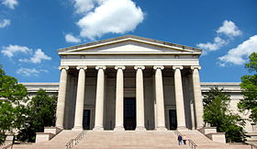



Making Connections:

Slide 37








Making Connections:

Slide 38
Need To Know- Chapter 5
The term “classical” when referring to the artistic contributions of the Greeks, is described as marked by clarity, balance, and harmonious proportion.
The best source of information to understand the Greek architectural module is The Ten Books on Architecture,” by Vitruvius Pollio.
Greek art is fundamentally realistic.
The Parthenon is dedicated to the goddess Athena, and makes use of the Doric order of architectural design.
Known as the female Homer, the poet Sappho produced nine books of lyric poetry and was from the isle of Lesbos.
In the Greek classical artistic canon, the distance between the chin and the top of the forehead accounted for one tenth of the human body.
At the onset of the Christian era, a fig leaf was placed over the genitalia of all nude Greek sculpture.

